Slide 1
IMAGE PROCESSING
Furkan Veysi Ekici

Slide 2
What is Image Processing?
The class of techniques known as "digital image processing" deals with applying computer algorithms to manipulate digital images.
Image processing is the process of improving an already-existing image or collecting important data from it.
Another use, particularly in the entertainment sector, is manipulation of images, such as the addition or removal of objects.

Slide 3
How Computers Understand?
A computer understands digital images as 2D or 3D matrices, where each value or pixel in the matrix represents the amplitude, sometimes referred to as the "intensity," of the pixel.
People who works with image processing often work with 8-bit pictures, in which the amplitude value is between 0 and 255. Various "types" of images are handled by computers according to their function representations.

Slide 4
Digital Image Types
1.Binary images
2. Grayscale Image
3. RGB Color Image
4.RGBA images

Slide 5
1.Binary images
2. Grayscale Image
Pictures in grayscale, often known as 8-bit pictures, are made up of 256 different colors, with black represented by a pixel intensity of 0 and white by a pixel intensity of 255.
The various colors of gray represent the remaining 254 values
Binary images are those that have just two possible pixel intensity values: 0 for black and 1 for white.
These pictures are usually used to draw attention to a specific area of a colorful picture.

Slide 6
3. RGB Color Image
4.RGBA Images
RGB color images consist of three 16-bit matrices representing the Red, Green, and Blue channels. Each pixel is defined by three coordinates, with values ranging from 0 to 255. Black is represented as (0, 0, 0), white as (255, 255, 255), and various combinations create different colors, such as red (255, 0, 0), green (0, 255, 0), and blue (0, 0, 255).
RGBA photos are RGB images that have been colored, with an additional channel called "alpha" that shows how opacity is applied to the RGB image.
Opacity is basically a "see-through" quality, with a value ranging from 0% to 100%.

Slide 7

Image Processing Techniques
Image processing can be applied to improve an image's quality, eliminate unneeded elements from an image, or even start from scratch and produce new images.
Image processing is a vast and complex field, with many different algorithms and techniques that can be used to achieve different results. Here are some of the techniques that can be used.
1: Image Enhancement
2: Image Restoration
3: Object Detection
4: Image Compression
5: Image Manipulation
6: Image Generation
7: Image-to-Image Translation

Slide 8
Phases of Image Processing

Slide 9
1.Image Acquisition
2. Image Enhancement
An analogue-to-digital converter is used to digitalize the image after it is taken by a camera and, if the camera output is not already digital, so that it can be processed further in a computer.
In this step, the acquired image is manipulated to meet the requirements of the specific task for which the image will be used. Such techniques are primarily aimed at highlighting the hidden or important details in an image, like contrast and brightness adjustment, etc.
3. Image Restoration
4. Color Image Processing
This step, which focuses on improving a picture's appearance, is objective since it may be connected to a mathematical or probabilistic model that explains why an image decreases. For instance, reducing image noise or blur.
This step aims at handling the processing of colored images (16-bit RGB or RGBA images), for example, peforming color correction or color modeling in images.

Slide 10
5. Wavelets and Multi-Resolution Processing
6. Image Compression
The fundamental units used to represent images at different resolutions are called wavelets. Images are successively divided into smaller parts for pyramidal representation and data compression.
Images are often compressed to transfer or due to storage limits. Online, platforms like Google use thumbnails for efficiency, only showing the full resolution when clicked, saving server bandwidth.
7. Morphological Processing
8. Image Segmentation
To represent and describe shape, image components are extracted using mathematical operations. For instance, erosion sharpens while dilation blurs object edges in images.
In this step image segmentation divides an image into key parts for a clearer analysis. It helps computers focus on vital areas, enhancing automated system performance.

Slide 11
9. Representation and Description
10. Object Detection and Recognition
After image segmentation, the next step determines if a segmented area is shown as a boundary or a full region. Description focuses on extracting attributes for relevant quantitative data or distinguishing object classes.
Once objects are segmented and described, the system labels them, identifying them as "vehicle," "person," etc., for user clarity.
11. Knowledge Base
The bounding box coordinates and object label of an object of interest located in the image could be all that is needed to know something. Anything that can be added to the knowledge base to help in the solution of the particular task at hand can be coded.

Slide 12
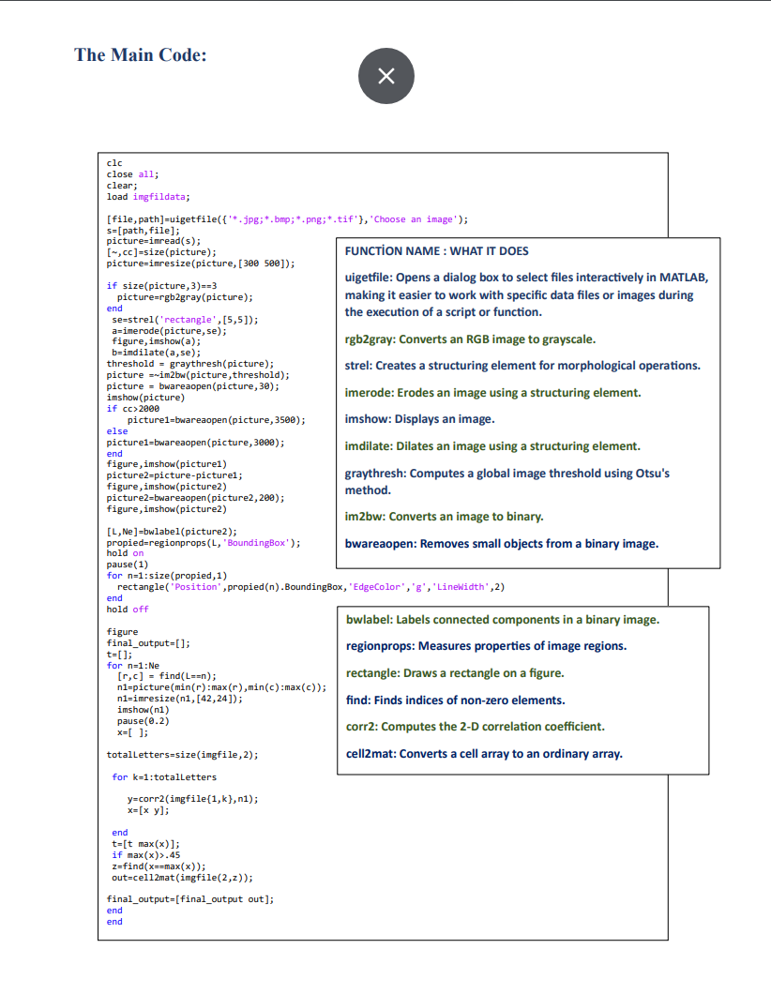
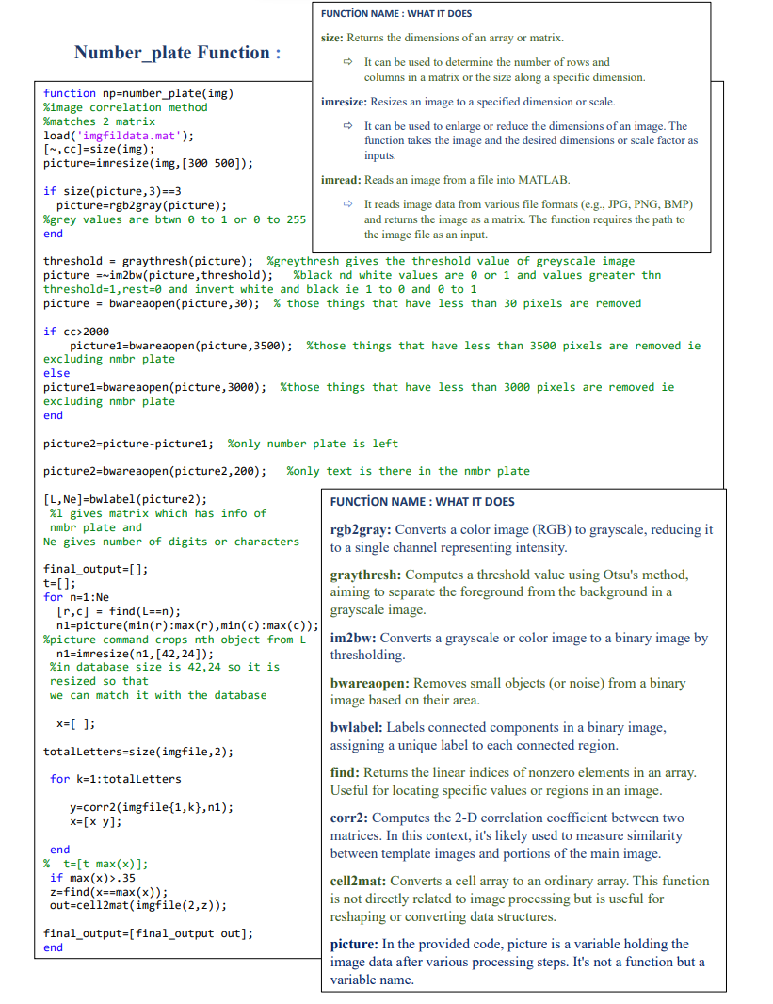
THE CODE
THECODE

Slide 13
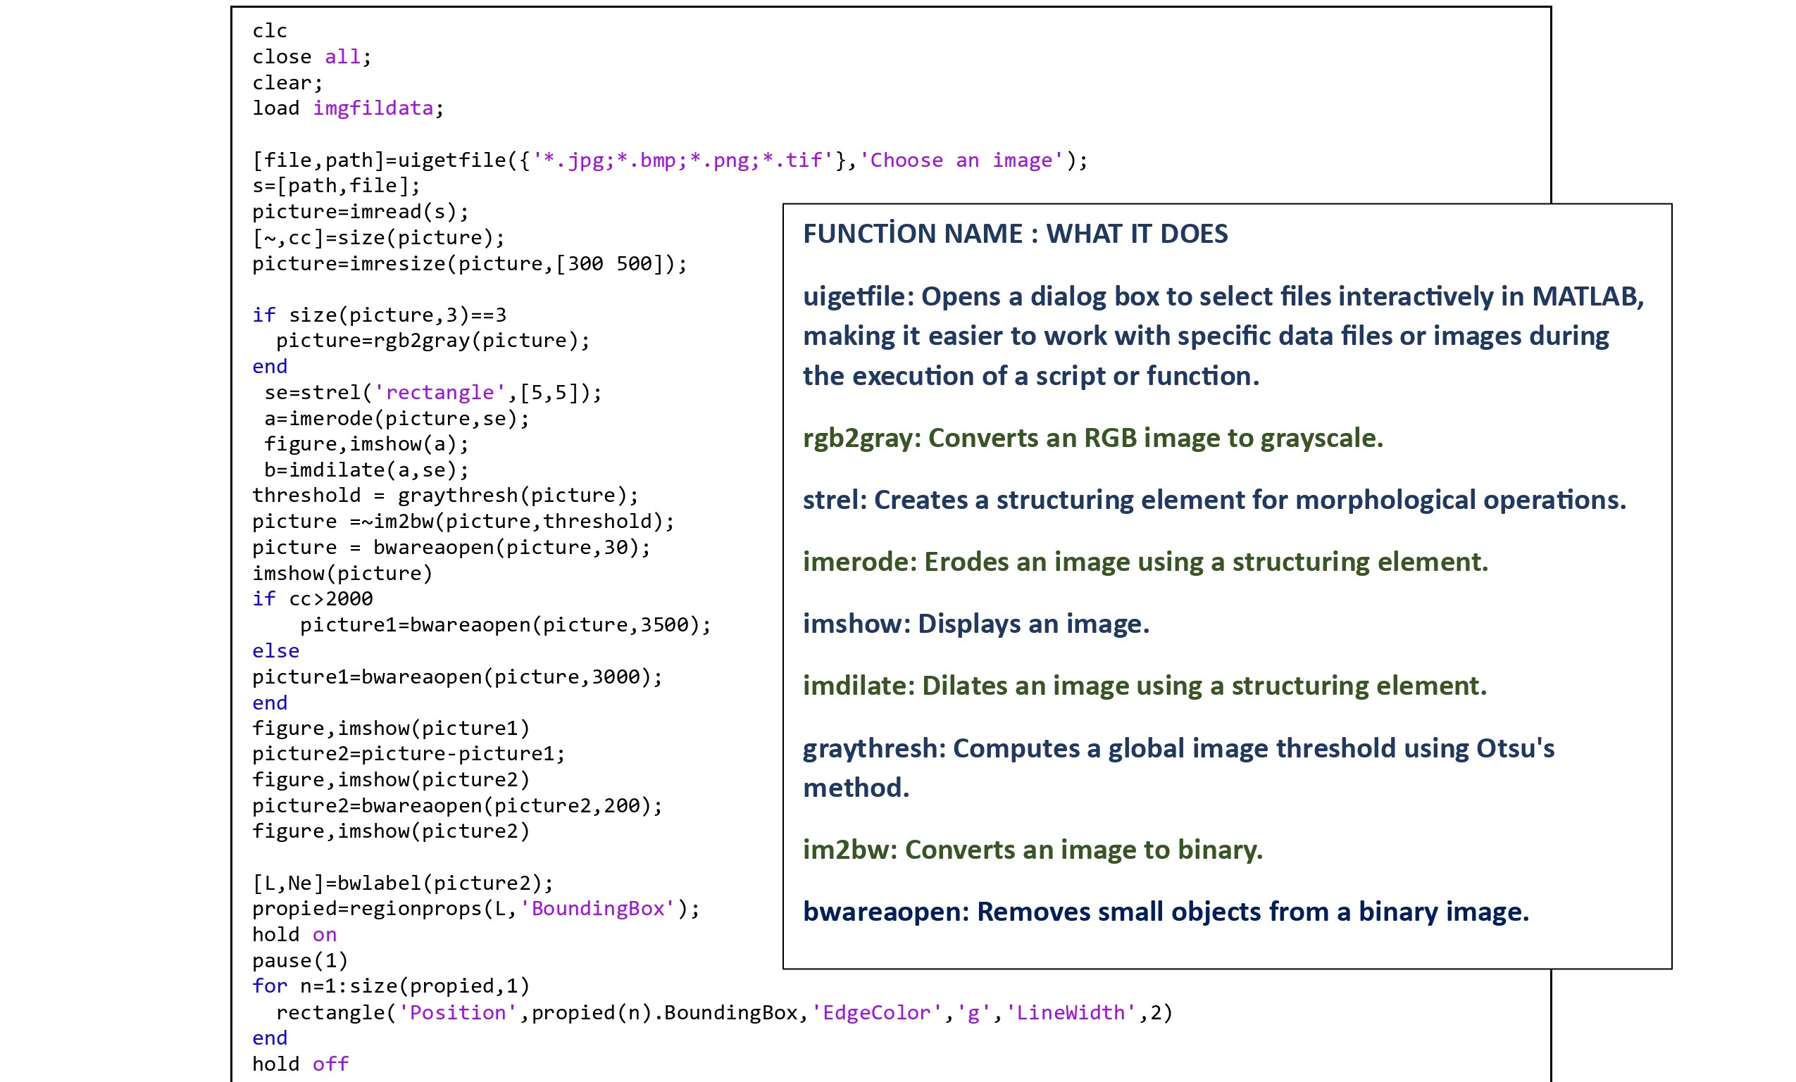
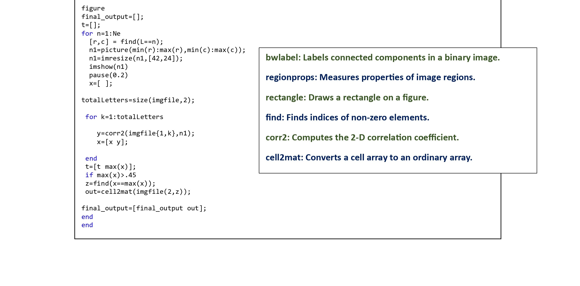
THEMAİN CODE

Slide 14
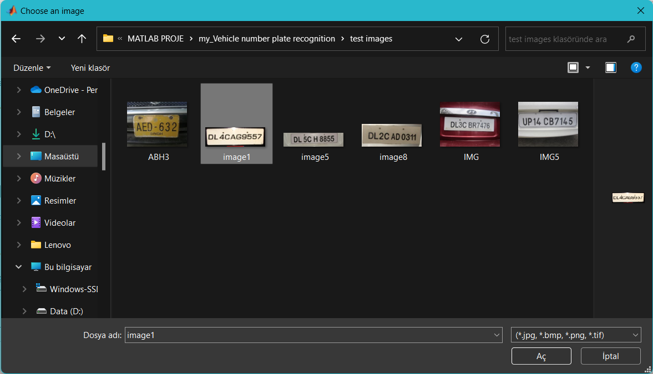
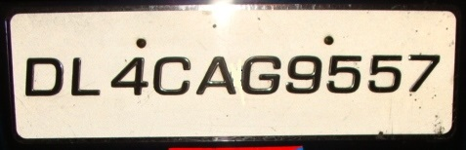
EXAMPLE

Slide 15
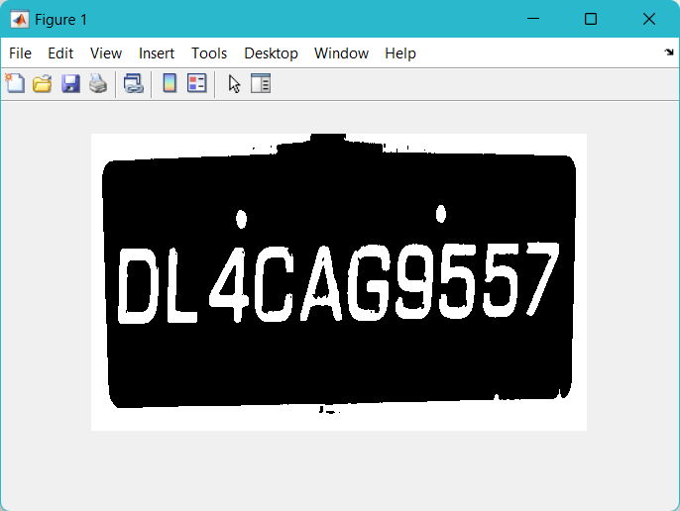
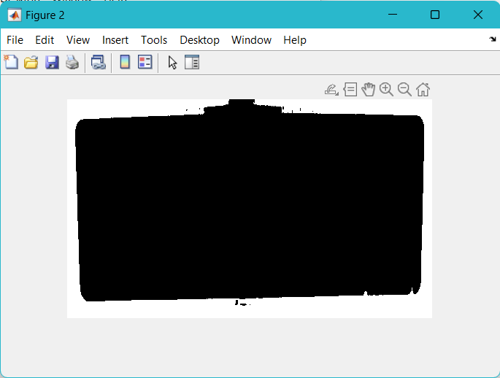
EXAMPLE

Slide 16
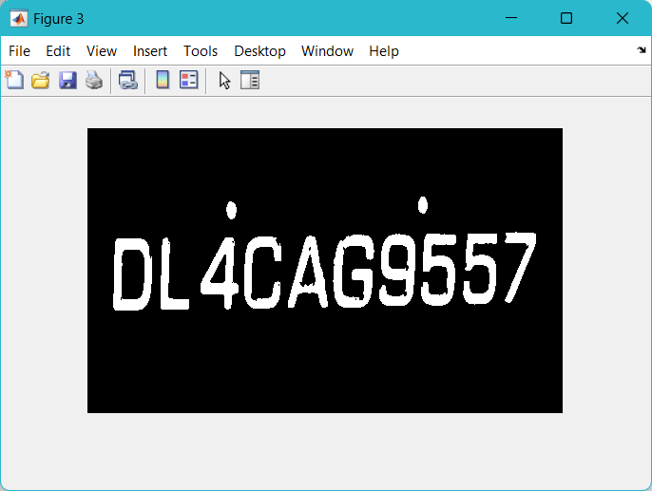
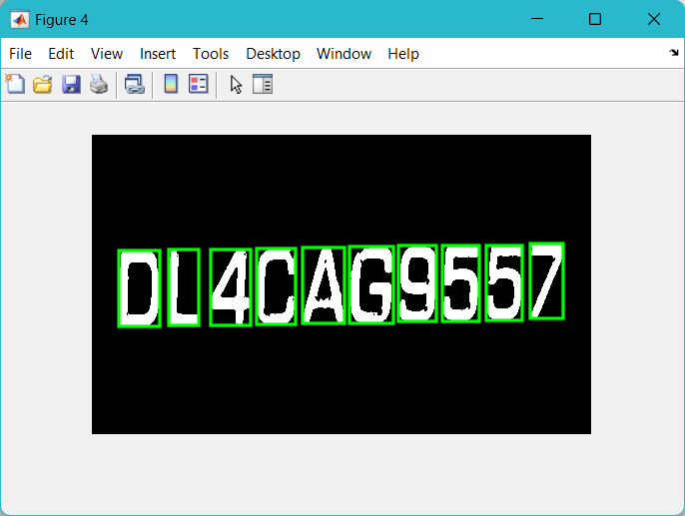
EXAMPLE

Slide 17

EXAMPLE

Slide 18
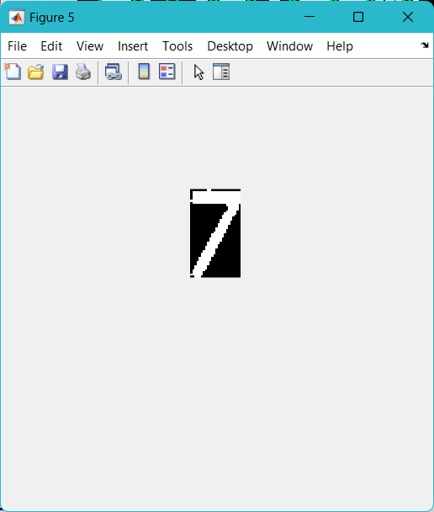
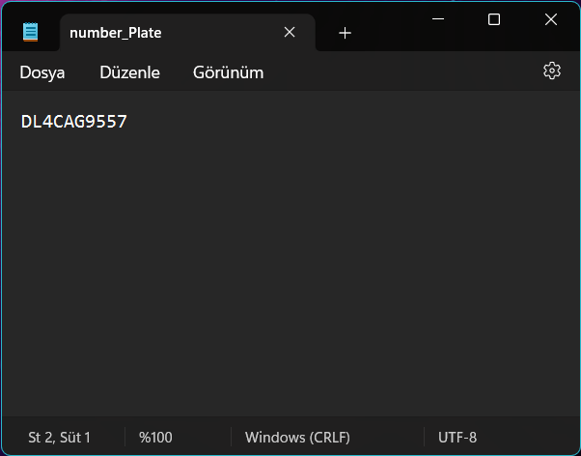
EXAMPLE

Slide 19
Sources
Codes:
https://uk.mathworks.com/matlabcentral/fileexchange/54456-licence-plate-recognition
Function explanations:
https://uk.mathworks.com/help/matlab/ref
Image Processing explanations:
https://www.v7labs.com/blog/image-processing-guide

